Slide 1
Graceful Failure During OOM Conditions

Slide 2
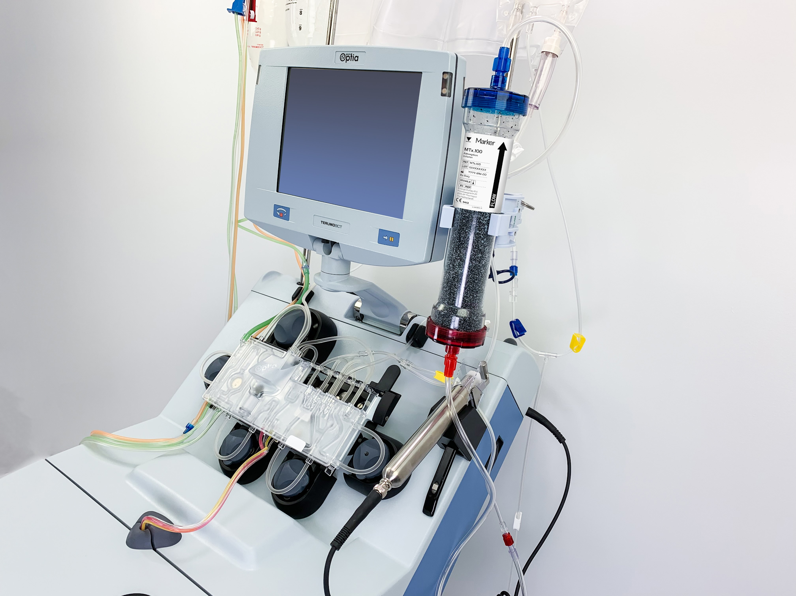
Embedded Systems
Combo of hardware and software with specific purpose
May be very simple or relatively complex
Some run variants of linux
Examples: remote sensors, medical devices, self driving car radar or gps, elevator control units, etc..

Slide 3

Memory Allocation And OOM Killer
Linux intends for “good” malloc() calls never to fail
If a mmap/malloc call fails due to lack of memory, OOM killer is activated
The OOM killer tries to kill processes to free memory
Complicated score to decide which process is killed, but primarily based on size of memory usage
Adjusted OOM Score in proc fs allows user to make a process less likely (or impossible) to be killed by OOM killer
But what if all killable processes have been killed?
Deadlock, unresponsiveness, and system crash as OS processes fail due to bad memory allocation calls.

Slide 4
Memory, OOM, and Embedded Systems
OOM conditions are less likely on embedded systems as workload is relatively well known and consistent. However…
Overcommit may cause OOM
Coding errors may cause memory leaks
Fundamental mismatch between hardware and task

Slide 5
Handling OOM Conditions -- Graceful failure
Currently two options -- let OOM killer kill process or mark process as unkillable and hope system can kill other processes
In some situations , it may be better for a process to fail and execute a “graceful shutdown” procedure rather than get killed by OOM killer, or cause an unresponsive state.
Real-time Embedded Systems
Medical Devices -- shut down and notify user of failure
Data Loggers -- transmit data and then shut down
Self Driving Car Radar -- gently apply brakes and notify user to take over

Slide 6
Design Fulfillment
Three main components of pipeline:
Detection/Prediction of Out of Memory Condition
Minimising Data Loss / Barebone Functionality
Graceful Shutdown

Slide 7
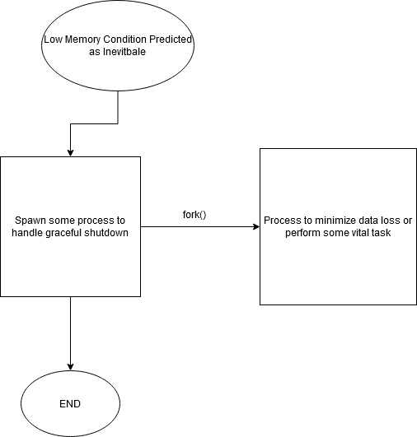
Spawning Processes

Slide 8
Spawning Processes cont’d
System Function | Process to Spawn
Data Logging | Write data stream to file
Safety Critical | Barebone Functionality
Monitoring Equipment | Raise Alarm

Slide 9
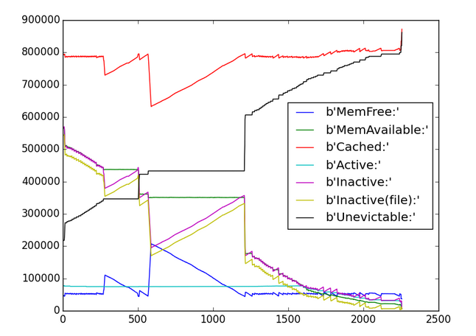
Predicting Out of Memory Condition
Gather Statistics
OOM Scores
CPU Load
/proc/meminfo
Combination of Factors
Kickstart Pipeline
Minimise Data Loss
Or Barebone Functionality
Graceful Shutdown

Slide 10
Graceful Shutdown
Three main components of pipeline:
Detection/Prediction of Out of Memory Condition
Minimising Data Loss / Barebone Functionality
Graceful Shutdown
Complete any other critical safety-measures
Call custom shutdown procedure, SIGTERM, SIGKILL?

Slide 11
Graceful Shutdown
Three main components of pipeline:
Detection/Prediction of Out of Memory Condition
Minimising Data Loss / Barebone Functionality
Graceful Shutdown
Complete any other critical safety-measures
Call custom shutdown procedure, SIGTERM, SIGKILL?

Slide 12
Graceful Shutdown
Current Proposed Solutions
Kernel Process related to SIGTERM or SIGUSR1
LKM / System Call Intercept
Solution Requirements
Customizable across platforms / OS
Has access to user-level process info and kernel-level

Slide 13
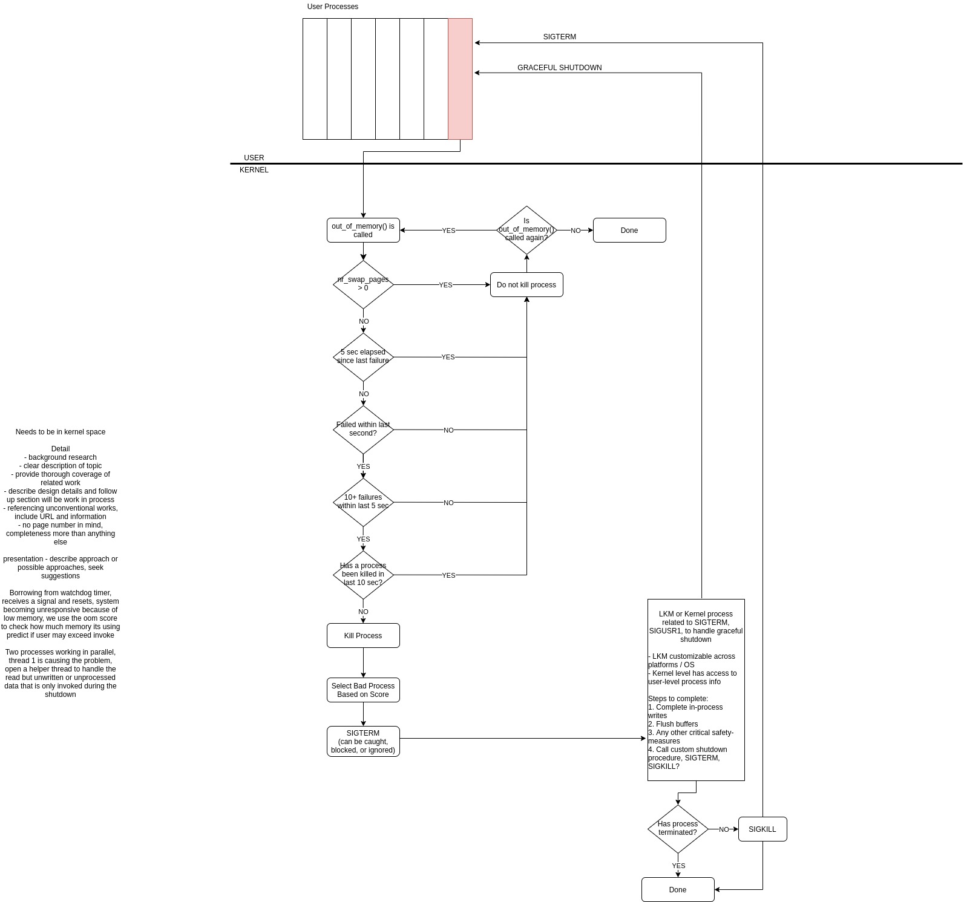
Graceful Shutdown

Slide 14
Graceful Shutdown

Slide 15
Graceful Shutdown

Slide 16
Graceful Shutdown

Slide 17
Graceful Shutdown
ORIGINAL USER PROCESS
GRACEFUL SHUTDOWN
SIGTERM

Slide 18
Graceful Shutdown - Method Pro / Con
LKM / System Call Intercept
PRO
Wraps existing functionality
Speed (as compared to process)
Can still invoke kernel process if needed
Users do not need to rebuild kernel
CON
Complexity of newer kernel security
Memory fragmentation
Loaded late in boot cycle
Kernel Mode Process
PRO
Premarked as “unkillable”
Access to kernel level and user space info
CON
Slower to create / manage
Likely slower than kernel execution
Notes:
Reference for memory allocation: https://tldp.org/HOWTO/Module-HOWTO/x627.html#MEMALLOC
Reference to kernel threads: https://www.tutorialspoint.com/user-level-threads-and-kernel-level-threads

Slide 19
Graceful Shutdown - Potential Implementations
Kernel Mode
Process
(if needed)
LKM
Assumptions:
Preallocate memory for process
We have pre-empted early enough to complete this
Move hardware
Raise alarms
SIGTERM
option 1
option 2
Has user process been killed?
Has user process been killed?
NO
SIGKILL
NO
SIGKILL
YES
YES
DONE
DONE

Slide 20
Questions?

